Slide 1


Take your seats
This workshop will begin soon
Make sure you visit and download the contents @ https://github.com/rmcuob/tkinter-workshop
to follow along

Slide 2
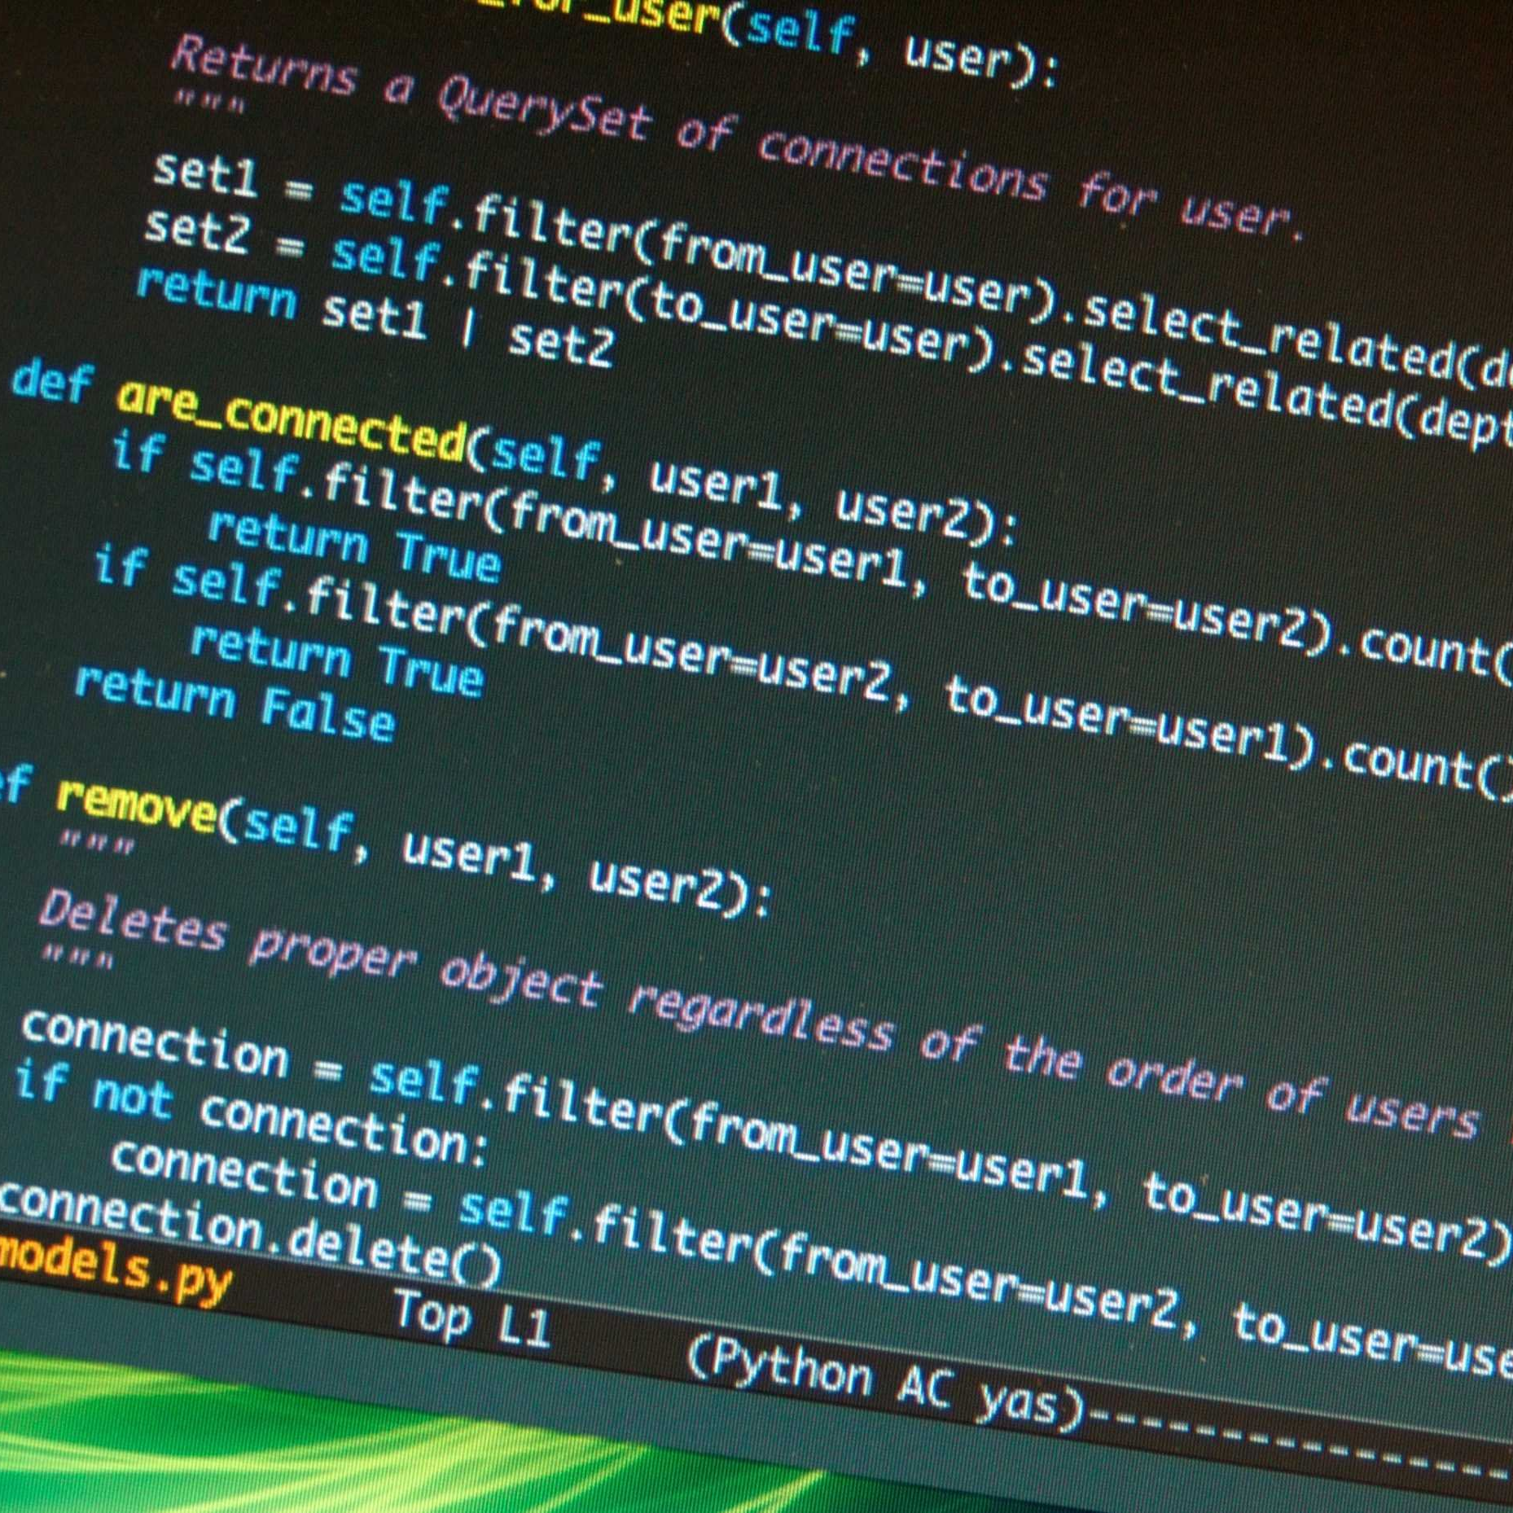
Workshop Content & Plan:
Creating and setting up a Tkinter window
Adding and configuring widgets
Calling functions using widgets
Event handling
10 minutes break
30 minutes hands on project
Adding Images to the tkinter window
Creating multiple windows
Hands-on project

Slide 3
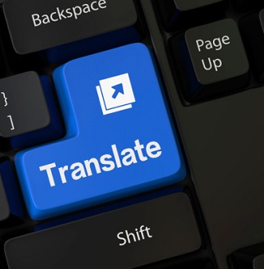
Definitions:
GUI :
Stands for "Graphical User Interface" and is pronounced "gooey." It is a user interface that includes graphical elements, such as windows, icons and buttons that allow the user to interact with electronic devices.
Widgets:
component of an interface, that enables a user to perform a function or access a service (interact with electronic devices).

Slide 4

Setting up your tools
from tkinter import *

Slide 5
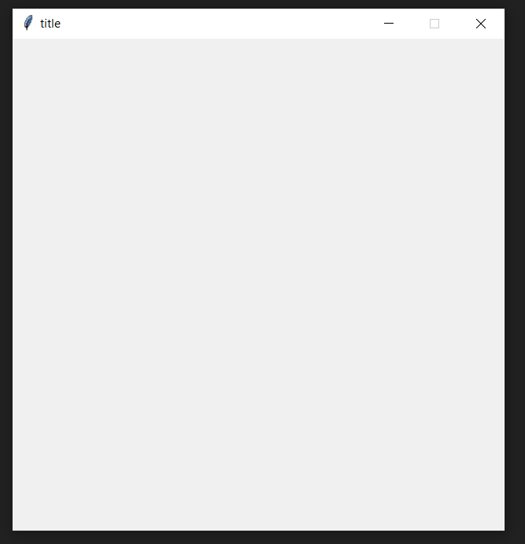
Setting up your window
root = Tk() # creates a window variable
root.title("GUI with RMC") # sets a window title
root.configure(width=500, height=500)
# sets window width and height
root.resizable(width=False, height=False)
# prevents window resizing
# enter your code here
root.mainloop()
#ensures window stays on the screen

Slide 6

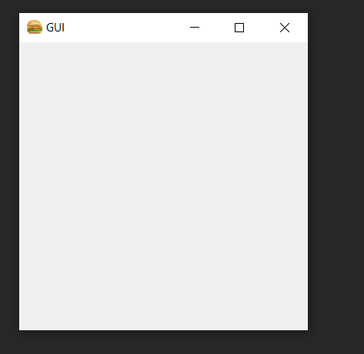
Adding a Window Icon
root.iconbitmap(r'C:\Users\Mahmoud Matar\Desktop\RMC\Python GUI workshop\presentation images\burger.ico')

Slide 7
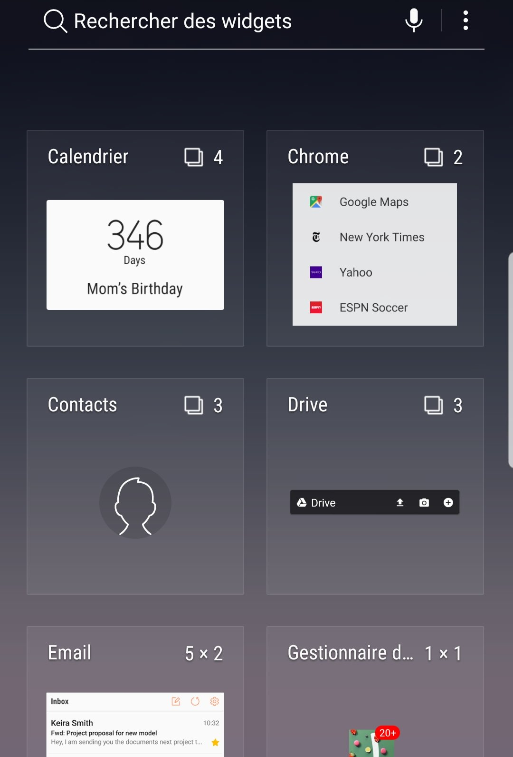
Let’s add some Widgets!
Adding a Label:
label1 = Label(root, text="Welcome to tkinter", font=("arial", 16, "bold", "italic"), fg="red", bg="yellow", relief="solid“, padx=10, pady=10) # Adding a label widget
label1.pack() # randomly place the label on the screen
# fg stands for foreground color
# bg stands for background color
# relief is a certain simulated 3-D effects around the outside of the widget
# padx and pady for changing the size of the label in the x and y
direction, respectively.

Slide 8
Let’s add some Widgets!
Adding a Button:
button1 = Button(root, text="Welcome to tkinter", font=("arial", 16, "bold", "italic"), fg="red", bg="yellow", relief="solid" , padx=10, pady=10) # Adding a button widget
button1.place(x=100, y=0)
# place allows us to dynamically place the widget anywhere on the
screen. Values provided for x and y are in pixels

Slide 9
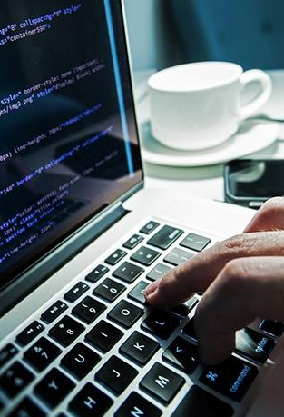
The command parameter
def display(): # function to be called when button is pressed
print("Hello")
button1 = Button(root, text="Welcome to tkinter", font=("arial", 16, "bold", "italic"), fg="red", bg="yellow", relief="solid“, padx=10, pady=10, command = display) # Adding a button widget

Slide 10
The config function
def changeText(): # function to be called when button is pressed
button1.config(text= "Text changed")
# Adding a button widget
button1 = Button(root,
text="Welcome to tkinter",
font=("arial", 16, "bold", "italic"),
fg="red",
bg="yellow",
relief="solid“,
padx=10,
pady=10,
command = changeText)

Slide 11

Creating an Entry Widget
Step 1 : Create a string Variable
Definition:
Variables that can be used with most entry widgets to track changes to the entered value
Format:
var = StringVar() # where var is any variable name of your choice
Methods:
var.get() #The get method returns the current value of the variable
var.set(<string>) # The set method updates the variable

Slide 12
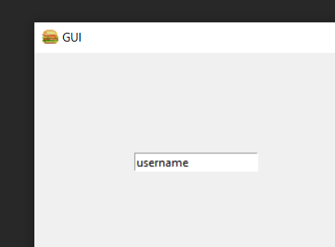
Let’s add some Widgets!
To add an Entry:
username = StringVar() # create a string variable
entry1 = Entry(root, textvar=username) # creates an entry widget
username.set(“click me”)

Slide 13
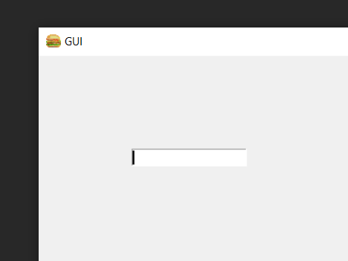
The bind function (event handling)
def entry1pressed(event): # call-back function
if(username.get() == "username"):
username.set("")
entry1.bind("<Button-1>", entry1pressed) # this function causes a function to be executed whenever an ‘event’ happens. The first parameter is event name and the second parameter is the handler

Slide 14
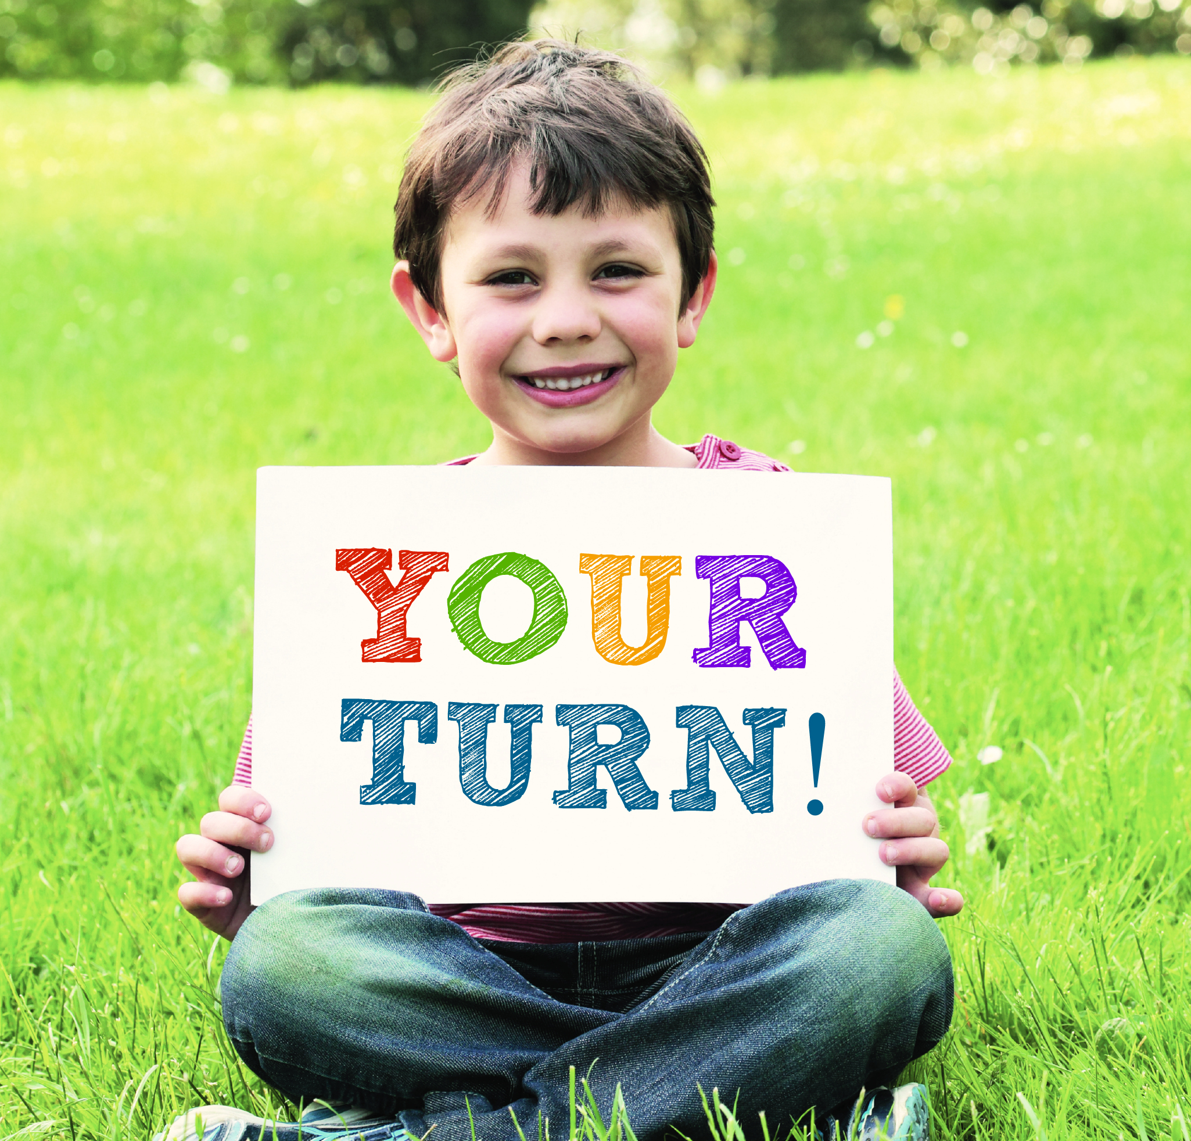
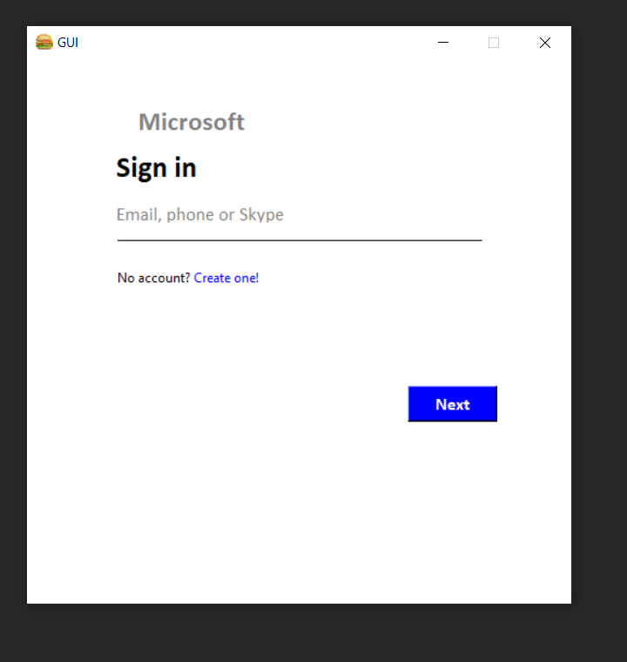
It’s your turn!
Task:
Create the following Graphical user interface

Slide 15
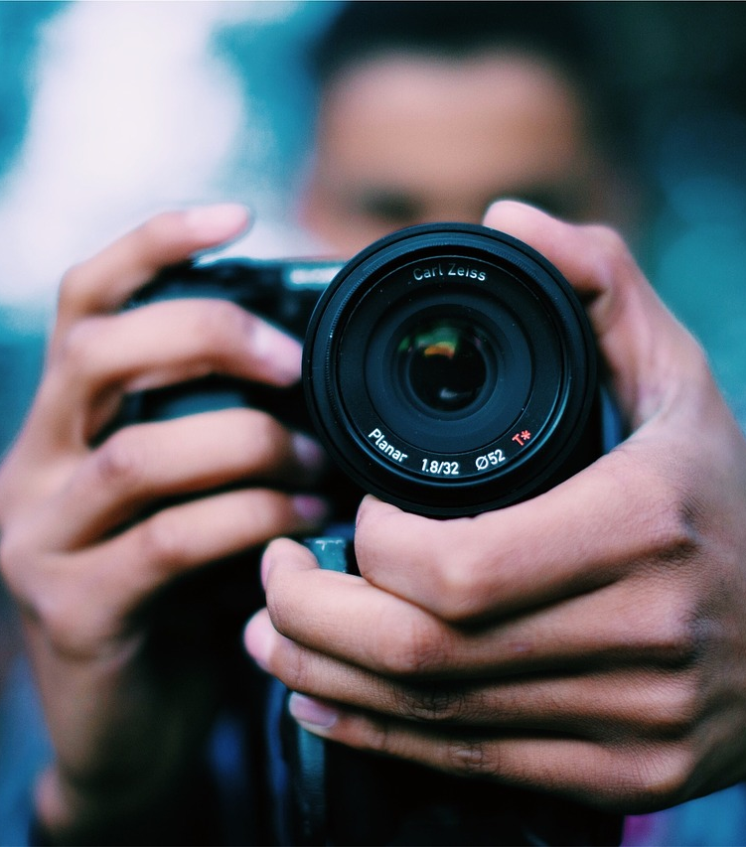
Let’s add an Image!
Adding an Image to our Tkinter window is done via the help of another Library called Pillow
from PIL import Image, ImageTk

Slide 16
Let’s add an Image!
Adding the image is done in 3 steps:
Load the image from a file
Create a Tkinter compatible image
Displaying the image via a Label onto the Tkinter window

Slide 17
Let’s add an Image!
loader = Image.open(<image path>)
photo = ImageTk.PhotoImage(loader)
img_label = Label(root, image=photo)

Slide 18
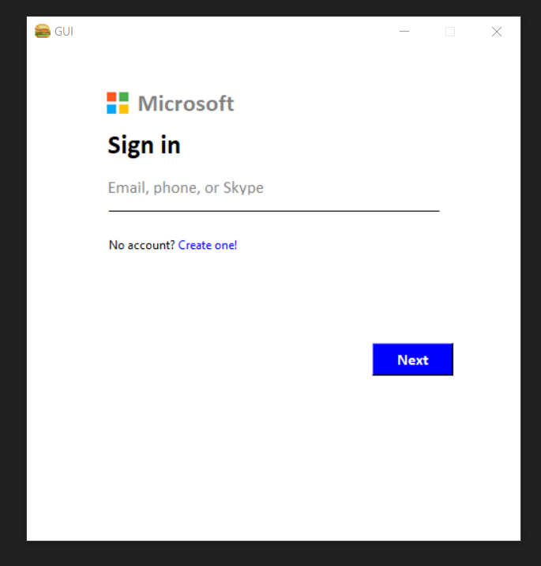
Let’s add an Image!

Slide 19
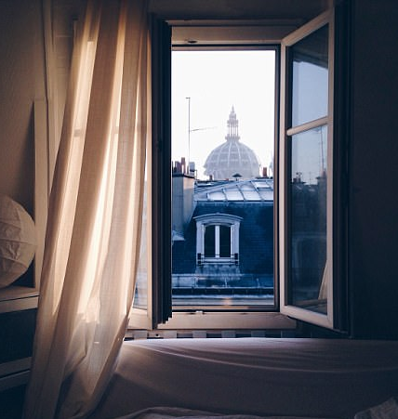
Creating New Window!
window2 = TopLevel()
Note: we usually create the new window along with its widgets and configuration inside a function and call it when we press a button in the main window (root)

